Slide 1
Automated News Classification Using Machine Learning
Guided by: Dr.Afzal Hussian Shahid
M.Jayasree: 23BCE9335
J.Manjiswari: 23BCE9340

Slide 2
Introduction
Large amount of news is generated daily
Manual classification is difficult and time-consuming
Need for automation
Machine learning helps classify news automatically
This Project focuses on building an automated news classification system using TF-IDF,Naive Bayes and SVM

Slide 3
Objectives
To develop an automated news classification system using machine learning
To use the 20 Newsgroups dataset for training and testing the model
To convert text data into numerical form using TF-IDF technique
To implement Naive Bayes and SVM algorithms for classification
To evaluate model performance using:
Accuracy
Classification Report
Confusion Matrix

Slide 4
Models Used
Methodology :Naive Bayes Model
Split dataset into training and testing data
Convert text into TF-IDF features
Train Multinomial Naïve Bayes model
Predict categories for test data
Evaluate using accuracy, confusion matrix and Classification Report

Slide 5
Models Used
Methodology – SVM
Split dataset into training and testing data
Convert text into TF-IDF features
Train Support Vector Machine (SVM) model
Predict categories for test data
Evaluate using accuracy,confusion matrix and Classification Report

Slide 6
Dataset Overview
Uses the 20 Newsgroups dataset with multiple news categories
Contains text documents from topics like sports, politics, and science
Split into training and testing data
Provides sufficient data for model training and evaluation

Slide 7
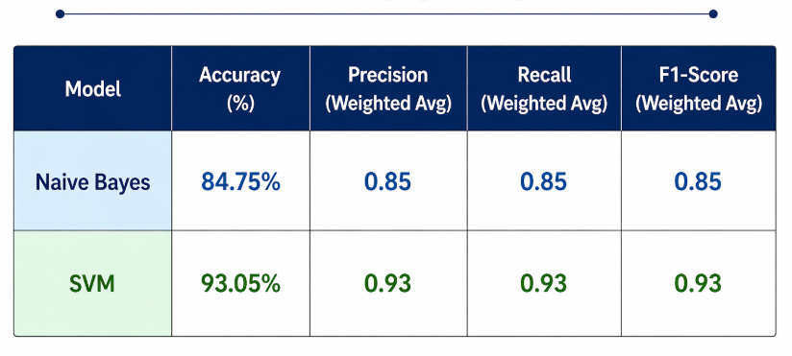
Results

Slide 8
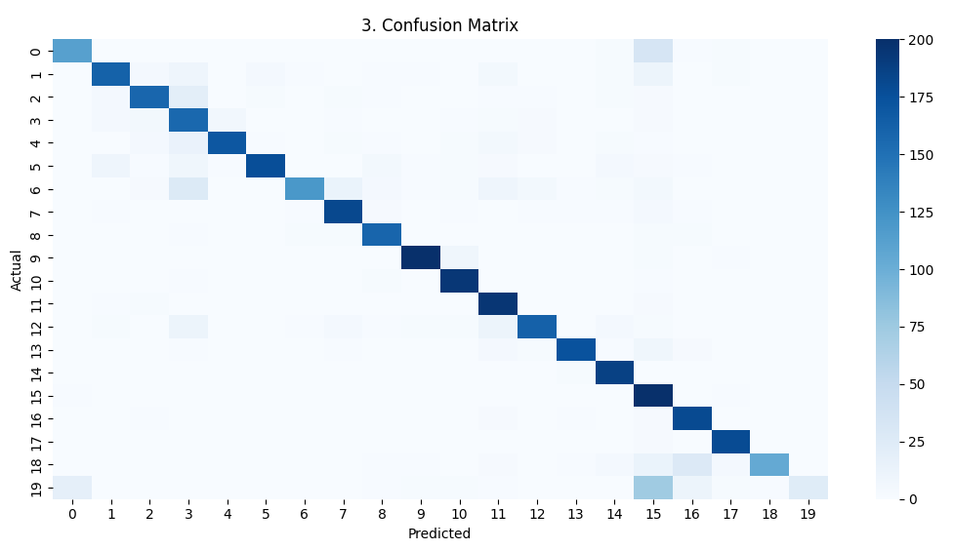
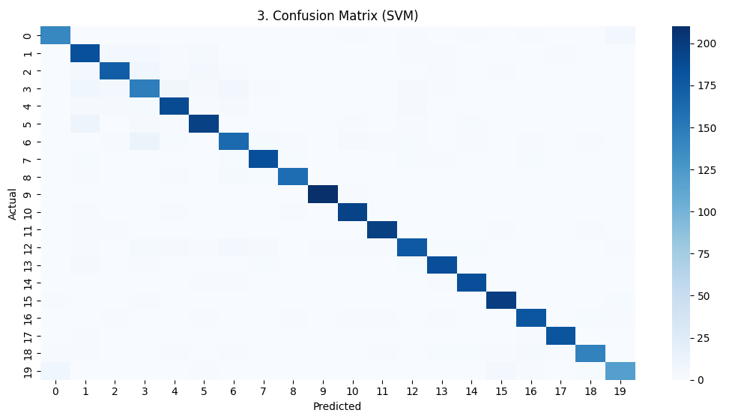
confusion Matrix: Naïve Bayes
Confusion matrix: SVM

Slide 9
Advantages
Saves Time and Effort
Automatically classifies news articles, reducing manual work.
High Accuracy
Machine learning models like Naive Bayes and SVM provide reliable results.
Efficient Handling of Large Data
Can process and organize a huge number of news articles quickly.
Improves Organization
News is neatly categorized into predefined classes.

Slide 10
Applications
News Websites & Apps
Automatically categorize articles into topics like sports, politics, technology.
Search Engines
Improves search results by organizing content into relevant categories.
Content Recommendation Systems
Suggests personalized news to users based on their interests.
Social Media Platforms
Helps organize posts and trending topics efficiently

Slide 11
Conclusion
This project successfully developed an automated news classification system using machine learning techniques.
Text data was effectively transformed into numerical features using TF-IDF, enabling accurate model training.
Both Naive Bayes and Support Vector Machine (SVM) algorithms were implemented and evaluated.
The results show that SVM achieved higher accuracy and better overall performance compared to Naive Bayes.

Slide 12
THANK YOU

